Slide 1

CO4 – Concurrency

Slide 2
Operating Systems Design​ Session 31: Locking: Spin Locks
19CS2106R​
© 2020 KL University

Slide 3
Recap of CO3
Operating system organization: creating and running the first process, Page tables: Paging, hardware, Process address space
Page tables: Physical memory allocation
Systems calls, exceptions and interrupts, Assembly trap handlers
Disk driver and Disk scheduling
Manipulation of the process address space
Page tables: User part of an address space, sbrk, exec
memory management policies: swapping, demand paging
memory management policies: Page faults and replacement algorithms
TLB, Segmentation
Hybrid approach: paging and Segmentation, Multi-level paging

Slide 4
CO4 Topics
Locking
Inter-process communication
Models of Inter-process communication
Thread API, Conditional Variable
Mutex, Concurrent Linked List
Semaphores
Concurrency Control Problems
Deadlocks
Boot Loader

Slide 5
Process memory layout
A program is a file containing a range of information that describes how to construct a process at run time.
The memory allocated to each process is composed of a number of parts, usually referred to as segments. These segments are as follows:
Text: the instructions of the program.
The initialized data segment contains global and static variables that are explicitly Initialized
The uninitialized data segment contains global and static variables that are not explicitly initialized.
Heap: an area from which programs can dynamically allocate extra memory.
Stack: a piece of memory that grows and shrinks as functions are called and return and that is used to allocate storage for local variables and function call linkage information
Several more segment types exist in an a.out, containing the symbol table, debugging information, linkage tables for dynamic shared libraries, and the like. These additional sections don't get loaded as part of the program's image executed by a process.
The size(1) command reports the sizes (in bytes) of the text, data, and bss segments. For example:
$ size /usr/bin/cc /bin/sh
text | data | bss | dec | hex | filename
79606 | 1536 | 916 | 82058 | 1408a | /usr/bin/cc
619234 | 21120 | 18260 | 658614 | a0cb6 | /bin/sh

Slide 6
Stack and Heap Segment
Stack Segment
The stack segment is used to store local variables, function parameters, and the return address. (A return address is the memory address where a CPU will continue its execution after the return from a function call).
Local variables are declared inside the opening left curly brace of a function body, including the main() or other left curly braces that are not defined as static. Thus, the scopes of those variables are limited to the function’s body. The life of a local variable is defined until the execution control is within the respective function body.
Heap Segment
The heap area is allocated to each process by the OS when the process is created. Dynamic memory is obtained from the heap. They are obtained with the help of the malloc(), calloc(), and realloc() function calls. Memory from the heap can only be accessed via pointers. Process address space grows and shrinks at runtime as memory gets allocated and deallocated. Memory is given back to the heap using free(). Data structures such as linked lists and trees can be easily implemented using heap memory. Keeping track of heap memory is an overhead. If not utilized properly, it may lead to memory leaks.

Slide 7
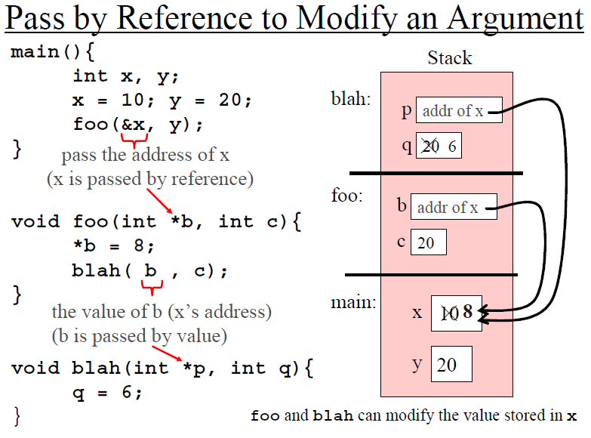
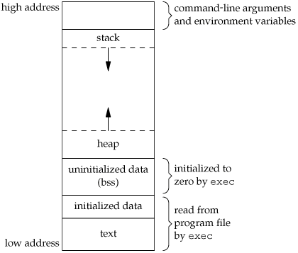
Typical memory arrangement

Slide 8
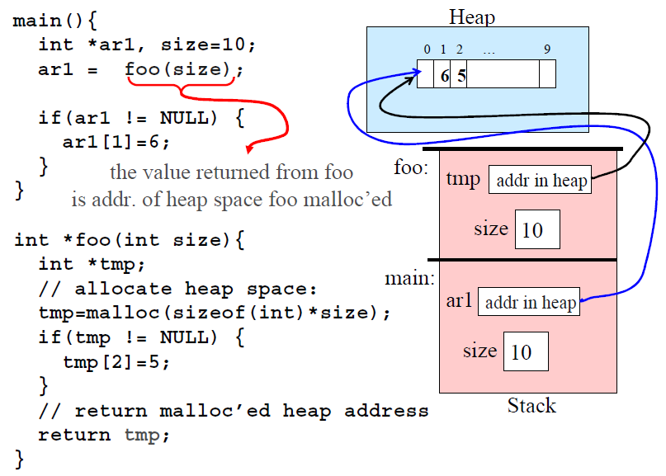
Typical memory arrangement

Slide 9
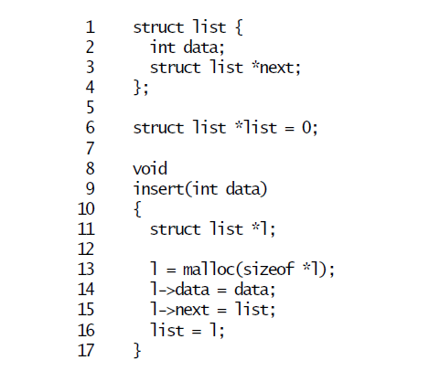
Race Condition Example - 1
As an example of why we need locks, consider several processors sharing a single
disk, such as the IDE disk in xv6. The disk driver maintains a linked list of the outstanding disk requests (4226) and processors may add new requests to the list concurrently (4354). If there were no concurrent requests, you might implement the linked list as follows:

Slide 10
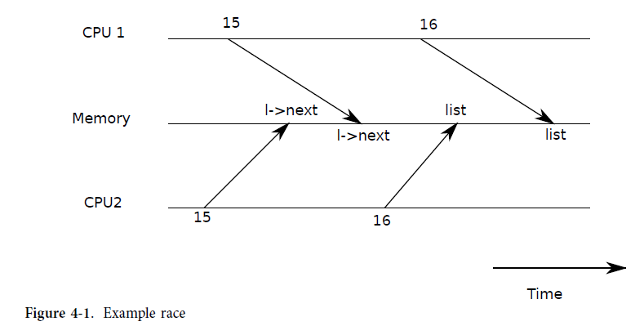
Race Condition
When multiple CPUs updating the same data simultaneously; without careful design such parallel access is likely to yield incorrect results or a broken data structure.
Race Condition occurs when multiple process are trying to do something with shared data and the final outcome depends on the order in which the processes run

Slide 11
Race Condition
This implementation is correct if executed in isolation. However, the code is not correct if more than one copy executes concurrently. If two CPUs execute insert at the same time, it could happen that both execute line 15 before either executes 16 (see Figure 4-1). If this happens, there will now be two list nodes with next set to the former value of list. When the two assignments to list happen at line 16, the second one will overwrite the first; the node involved in the first assignment will be lost.
The lost update at line 16 is an example of a race condition. A race condition is a situation in which a memory location is accessed concurrently, and at least one access is a write. A race is often a sign of a bug, either a lost update (if the accesses are writes) or a read of an incompletely-updated data structure. The outcome of a race depends on the exact timing of the two CPUs involved and how their memory operations are ordered by the memory system, which can make race-induced errors difficult to reproduce and debug.

Slide 12
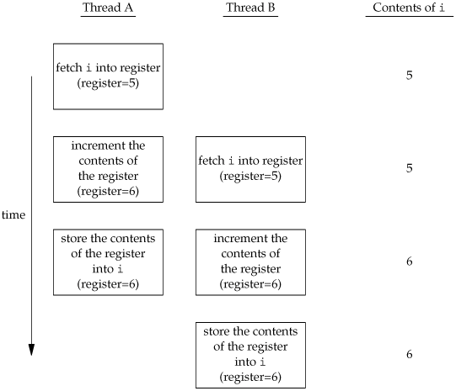
Race Condition example – 2 i = 5 (shared)
You also need to synchronize two or more threads that might try to modify the same variable at the same time. Consider the case in which you increment a variable . The increment operation is usually broken down into three steps.
Read the memory location into a register.
Increment the value in the register.
Write the new value back to the memory location.
When two or more processes are reading or writing some shared data and the final result depends on who runs precisely when, is called race condition.
Race condition occurs when two or more operations occur in an undefined manner
Race condition should be avoided because they can cause fine errors in applications and are difficult to debug

Slide 13
Simple example of the kind of problems that can occur when shared resources are not accessed atomically.
Sequence-number-increment Problem Example - 3
The technique used by the print spoolers is to have a file for each printer that contains the next sequence number to be used. The file is just a single line containing the sequence number in ASCII. Each process that needs to assign a sequence number goes through three steps:
1. it reads the sequence number file,
2. it uses the number, and it increments the number
3. and writes it back.
The problem is that in the time a single process takes to execute these three steps, another process can perform the same three steps. Chaos can result, as we will see in some examples that follow.

Slide 14
sequence-number-increment problem
#define MAXLINE 4096 /* max text line length */
#define SEQFILE "seqno" /* filename */
#define LOCKFILE "seqno.lock"
void my_lock(int), my_unlock(int);
int main(int argc, char **argv)
{int fd;
long i, seqno;
pid_t pid;
ssize_t n;
char line[MAXLINE + 1];
pid = getpid();
fd = open(SEQFILE, O_RDWR, 0666);
for (i = 0; i < 20; i++) {
my_lock(fd); /* lock the file */
lseek(fd, 0L, SEEK_SET); /* rewind before read */
n = read(fd, line, MAXLINE);
line[n] = '\0'; /* null terminate for sscanf */
n = sscanf(line, "%ld\n", &seqno);
printf("%s: pid = %ld, seq# = %ld\n", argv[0], (long) pid, seqno);
seqno++; /* increment sequence number */
snprintf(line, sizeof(line), "%ld\n", seqno);
lseek(fd, 0L, SEEK_SET); /* rewind before write */
write(fd, line, strlen(line));
my_unlock(fd); /* unlock the file */
}
exit(0);
}
void
my_lock(int fd)
{
return;
}
void
my_unlock(int fd)
{
return;
}

Slide 15
If the sequence number in the file is initialized to one, and a single copy of the program is run, we get the following output:
[vishnu@team-osd ~]$ cc seqnumnolock.c
[vishnu@team-osd ~]$ vi seqno
[vishnu@team-osd ~]$ ./a.out
./a.out: pid = 5448, seq# = 1
./a.out: pid = 5448, seq# = 2
./a.out: pid = 5448, seq# = 3
./a.out: pid = 5448, seq# = 4
./a.out: pid = 5448, seq# = 5
./a.out: pid = 5448, seq# = 6
./a.out: pid = 5448, seq# = 7
./a.out: pid = 5448, seq# = 8
./a.out: pid = 5448, seq# = 9
./a.out: pid = 5448, seq# = 10
./a.out: pid = 5448, seq# = 11
./a.out: pid = 5448, seq# = 12
./a.out: pid = 5448, seq# = 13
./a.out: pid = 5448, seq# = 14
./a.out: pid = 5448, seq# = 15
./a.out: pid = 5448, seq# = 16
./a.out: pid = 5448, seq# = 17
./a.out: pid = 5448, seq# = 18
./a.out: pid = 5448, seq# = 19
./a.out: pid = 5448, seq# = 20
When the sequence number is again initialized to one, and the program is run twice
in the background, we have the following output:
[vishnu@team-osd ~]$ vi seqno
[vishnu@team-osd ~]$ ./a.out & ./a.out &
[1] 7891
[2] 7892
[vishnu@team-osd ~]$ ./a.out: pid = 7892, seq# = 1
./a.out: pid = 7892, seq# = 2
./a.out: pid = 7892, seq# = 3
./a.out: pid = 7892, seq# = 4
./a.out: pid = 7892, seq# = 5
./a.out: pid = 7892, seq# = 6
./a.out: pid = 7892, seq# = 7
./a.out: pid = 7892, seq# = 8
./a.out: pid = 7892, seq# = 9
./a.out: pid = 7892, seq# = 10
./a.out: pid = 7892, seq# = 11
./a.out: pid = 7892, seq# = 12
./a.out: pid = 7892, seq# = 13
./a.out: pid = 7892, seq# = 14
./a.out: pid = 7891, seq# = 8
./a.out: pid = 7892, seq# = 15
./a.out: pid = 7892, seq# = 16
./a.out: pid = 7892, seq# = 17
./a.out: pid = 7891, seq# = 17
./a.out: pid = 7892, seq# = 18
./a.out: pid = 7891, seq# = 19
./a.out: pid = 7892, seq# = 19
./a.out: pid = 7892, seq# = 20
./a.out: pid = 7891, seq# = 20
./a.out: pid = 7891, seq# = 21
./a.out: pid = 7891, seq# = 22
./a.out: pid = 7891, seq# = 23
./a.out: pid = 7891, seq# = 24
./a.out: pid = 7891, seq# = 25
./a.out: pid = 7891, seq# = 26
./a.out: pid = 7891, seq# = 27
./a.out: pid = 7891, seq# = 28
./a.out: pid = 7891, seq# = 29
./a.out: pid = 7891, seq# = 30
./a.out: pid = 7891, seq# = 31
./a.out: pid = 7891, seq# = 32
./a.out: pid = 7891, seq# = 33
./a.out: pid = 7891, seq# = 34
./a.out: pid = 7891, seq# = 35
./a.out: pid = 7891, seq# = 36
[1]- Done ./a.out
[2]+ Done ./a.out

Slide 16
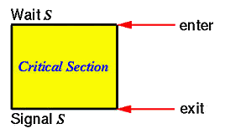
Critical Section
do {
critical section
} while (TRUE);
entry section
A critical section is a block of a code that only one process at a time can execute
The critical section problem is to ensure that only one process at a time is allowed to be operating in its critical section
Each process takes permission from operating system to enter into the critical section
exit section
The term critical section is used to refer to a section of code that accesses a shared resource and whose execution should be atomic; that is, its execution should not be interrupted by another thread that simultaneously accesses the same shared resource.

Slide 17
Mutual exclusion
If a process is executing in its critical section , then no other process is allowed to execute in the critical section
No two process can be in the same critical section at the same time. This is called mutual exclusion

Slide 18
Locks: The Basic Idea
Ensure that any critical section executes as if it were a single atomic instruction.
An example: the canonical update of a shared variable
Add some code around the critical section
balance = balance + 1;
1 lock_t lk; // some globally-allocated lock ‘mutex’
2 …
3 lock(&lk);
4 balance = balance + 1;
5 unlock(&lk);

Slide 19
Locks: The Basic Idea
Lock variable holds the state of the lock.
available (or unlocked or free)
No thread holds the lock.
acquired (or locked or held)
Exactly one thread holds the lock and presumably is in a critical section.

Slide 20
The semantics of the lock()
lock()
Try to acquire the lock.
If no other thread holds the lock, the thread will acquire the lock.
Enter the critical section.
This thread is said to be the owner of the lock.
Other threads are prevented from entering the critical section while the first thread that holds the lock is in there.

Slide 21
Building A Lock
Efficient locks provided mutual exclusion at low cost.
Building a lock need some help from the hardware and the OS.

Slide 22
Design

Slide 23
Evaluating locks – Basic criteria
Mutual exclusion
Does the lock work, preventing multiple threads from entering a critical section?
Fairness
Does each thread contending for the lock get a fair shot at acquiring it once it is free? (Starvation)
Performance
The time overheads added by using the lock

Slide 24
Controlling Interrupts
Disable Interrupts for critical sections
One of the earliest solutions used to provide mutual exclusion
Invented for single-processor systems.
Problem:
Require too much trust in applications
Greedy (or malicious) program could monopolize the processor.
Do not work on multiprocessors
Code that masks or unmasks interrupts be executed slowly by modern CPUs
void lock() {
DisableInterrupts();
}
void unlock() {
EnableInterrupts();
}

Slide 25
Why hardware support needed?
First attempt: Using a flag denoting whether the lock is held or not.
The code below has problems.
typedef struct __lock_t { int flag; } lock_t;
void init(lock_t *mutex) {
// 0 → lock is available, 1 → held
mutex->flag = 0;
}
void lock(lock_t *mutex) {
while (mutex->flag == 1) // TEST the flag
; // spin-wait (do nothing)
mutex->flag = 1; // now SET it !
}
void unlock(lock_t *mutex) {
mutex->flag = 0;
}

Slide 26
Why hardware support needed? (Cont.)
Problem 1: No Mutual Exclusion (assume flag=0 to begin)
Problem 2: Spin-waiting wastes time waiting for another thread.
So, we need an atomic instruction supported by Hardware!
test-and-set instruction, also known as atomic exchange
Thread1
Thread2
call lock()
while (flag == 1)
interrupt: switch to Thread 2
call lock()
while (flag == 1)
flag = 1;
interrupt: switch to Thread 1
flag = 1; // set flag to 1 (too!)

Slide 27
Test And Set (Atomic Exchange)
An instruction to support the creation of simple locks
return(testing) old value pointed to by the ptr.
Simultaneously update(setting) said value to new.
This sequence of operations is performed atomically.
int TestAndSet(int *ptr, int new) {
int old = *ptr; // fetch old value at ptr
*ptr = new; // store ‘new’ into ptr
return old; // return the old value
}

Slide 28
A Simple Spin Lock using test-and-set
Note: To work correctly on a single processor, it requires a preemptive scheduler.
typedef struct __lock_t {
int flag;
} lock_t;
void init(lock_t *lock) {
// 0 indicates that lock is available,
// 1 that it is held
lock->flag = 0;
}
void lock(lock_t *lock) {
while (TestAndSet(&lock->flag, 1) == 1)
; // spin-wait
}
void unlock(lock_t *lock) {
lock->flag = 0;
}

Slide 29
A Simple Spin Lock using open()
We are guaranteed that only one process at a time can create the file (i.e., obtain the lock), and to release the lock, we just unlink the file
void
my_lock(int fd)
{
int tempfd;
while ( (tempfd = open(LOCKFILE, O_RDWR|O_CREAT|O_EXCL, 0644)) < 0) {
if (errno != EEXIST)
printf("open error for lock file");
/* someone else has the lock, loop around and try again */
}
close(tempfd); /* opened the file, we have the lock */
}
void
my_unlock(int fd)
{
unlink(LOCKFILE); /* release lock by removing file */
}

Slide 30
Evaluating Spin Locks
Correctness: yes
The spin lock only allows a single thread to entry the critical section.
Fairness: no
Spin locks don’t provide any fairness guarantees.
Indeed, a thread spinning may spin forever.
Performance:
In the single CPU, performance overheads can be quire painful.
If the number of threads roughly equals the number of CPUs, spin locks work reasonably well.

Slide 31
Load-Linked and Store-Conditional
Test whether the value at the address(ptr) is equal to expected.
If so, update the memory location pointed to by ptr with the new value.
In either case, return the actual value at that memory location.
int CompareAndSwap(int *ptr, int expected, int new) {
int actual = *ptr;
if (actual == expected)
*ptr = new;
return actual;
}
Compare-and-Swap hardware atomic instruction (C-style)
void lock(lock_t *lock) {
while (CompareAndSwap(&lock->flag, 0, 1) == 1)
; // spin
}
Spin lock with compare-and-swap

Slide 32
Load-Linked and Store-Conditional
int LoadLinked(int *ptr) {
return *ptr;
}
int StoreConditional(int *ptr, int value) {
if (no one has updated *ptr since the LoadLinked to this address) {
*ptr = value;
return 1; // success!
} else {
return 0; // failed to update
}
}
The store-conditional only succeeds if no intermittent store to the address has taken place.
success: return 1 and update the value at ptr to value.
fail: the value at ptr is not updates and 0 is returned.

Slide 33
Load-Linked and Store-Conditional (Cont.)
void lock(lock_t *lock) {
while (1) {
while (LoadLinked(&lock->flag) == 1)
; // spin until it’s zero
if (StoreConditional(&lock->flag, 1) == 1)
return; // if set-it-to-1 was a success: all done
otherwise: try it all over again
}
}
void unlock(lock_t *lock) {
lock->flag = 0;
}
Using LL/SC To Build A Lock
void lock(lock_t *lock) {
while (LoadLinked(&lock->flag)||!StoreConditional(&lock->flag, 1))
; // spin
}
A more concise form of the lock() using LL/SC

Slide 34
Implementation of locks in xv6

Slide 35
Locking Introduction
xv6 runs on multiprocessors
Computers with multiple CPUs executing independently
These multiple CPUs share physical RAM, and xv6 exploits the sharing to maintain data structures that all CPUs read and write
This sharing raises the possibility of one CPU reading a data structure while another CPU is mid-way through updating it
When multiple CPUs updating the same data simultaneously; without careful design such parallel access is likely to yield incorrect results or a broken data structure.

Slide 36
Locking Introduction
Even on a uni-processor, an interrupt routine that uses the same data as some interruptible code could damage the data if the interrupt occurs at just the wrong time
Any code that accesses shared data concurrently must have a strategy for maintaining correctness despite concurrency.
The concurrency may arise from accesses by multiple cores, or by multiple threads, or by interrupt code.
xv6 uses a handful of simple concurrency control strategies; much more sophistication is possible - lock

Slide 37
Locking Introduction
A lock provides mutual exclusion, ensuring that only one CPU at a time can hold the lock.
If a lock is associated with each shared data item, and the code always holds the associated lock when using a given item, then we can be sure that the item is used from only one CPU at a time.
In this situation, we say that the lock protects the data item.

Slide 38
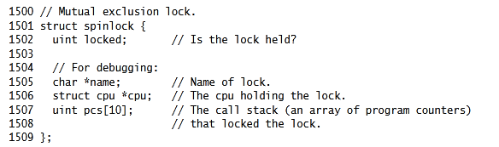
Code: Locks
xv6 has two types of locks: spin-locks and sleep-locks.
xv6 represents a spin-lock as a struct spinlock.

Slide 39
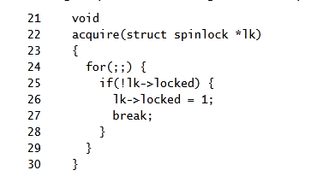
Code: Locks
The important field in the structure is locked
a word that is zero when the lock is available and non-zero when it is held.
Logically, xv6 should acquire a lock by executing code like

Slide 40
Code: Locks
This code does not guarantee mutual exclusion on a multi-processor.
It could happen that two CPUs simultaneously reach line 25
lk->locked
If it is zero then both grab the lock by executing line 26
lk->locked = 1;
At this point, two different CPUs hold the lock, which violates the mutual exclusion property.
Rather than helping us avoid race conditions, this implementation of acquire has its own race condition.
The problem here is that lines 25 and 26 executed as separate actions.
In order for the routine above to be correct, lines 25 and 26 must execute in one atomic(i.e., indivisible) step

Slide 41
Code: Locks
To execute those two lines atomically, xv6 relies on a special x86 instruction , xchg
xchg(volatile uint *addr, uint newval)
Locks (i.e., spinlocks) in xv6 are implemented using the xchg atomic instruction
In one atomic operation, xchg swaps a word in memory with the contents of a register.
The function acquire repeats this xchg instruction in a loop
acquire(struct spinlock *lk)
Each iteration atomically reads lk->locked and sets it to 1
while(xchg(&lk->locked,1)!=0)

Slide 42
Code: Locks
If the lock is already held, lk->locked will already be 1, so the xchg returns 1 and the loop continues.
If the xchg returns 0, however , acquire has successfully acquired the lock->locked was 0 and is now 1—so the loop can stop.
Once the lock is acquired , acquire records, for debugging, the CPU and stack trace that acquired the lock.
If a process forgets to release a lock, this information can help to identify the culprit.
These debugging fields are protected by the lock and must only be edited while holding the lock.

Slide 43
Code: Locks
The function release is the opposite of acquire: it clears the debugging fields and then releases the lock.
release(struct spinlock *lk)
The function uses an assembly instruction to clear locked, because clearing this field should be atomic so that the xchg instruction won’t see a subset of the 4 bytes that hold locked updated.
The x86 guarantees that a 32-bit movl updates all 4 bytes atomically.

Slide 44
Code: Using locks
xv6 uses locks in many places to avoid race conditions
A hard part about using locks is deciding how many locks to use and which data and invariants each lock protects.
There are a few basic principles.
First, any time a variable can be written by one CPU at the same time that another CPU can read or write it, a lock should be introduced to keep the two operations from overlapping.
Second, remember that locks protect invariants: if an invariant involves multiple memory locations, typically all of them need to be protected by a single lock to ensure the invariant is maintained.

Slide 45
Code: Using locks
These two rules says when locks are necessary but say nothing about when locks are unnecessary
It is important for efficiency not to lock too much, because locks reduce parallelism.
If parallelism isn’t important, then one could arrange to have only a single thread and not worry about locks.
A simple kernel can do this on a multiprocessor by having a single lock that must be acquired on entering the kernel and released on exiting the kernel

Slide 46
Sleep locks
Sometimes xv6 code needs to hold a lock for a long time.
For example, the file system keeps a file locked while reading and writing its content on the disk, and these disk operations can take tens of milliseconds.
Efficiency demands that the processor be yielded while waiting so that other threads can make progress, and this in turn means that xv6 needs locks that work well when held across context switches.
xv6 provides such locks in the form of sleep-locks.
Xv6 sleep-locks support yielding the processor during their critical sections.

Slide 47
Sleep locks
This property poses a design challenge: if thread T1 holds lock L1 and has yielded the processor, and thread T2 wishes to acquire L1, we have to ensure that T1 can execute while T2 is waiting so that T1 can release L1.
T2 can’t use the spin-lock acquire function here: it spins with interrupts turned off, and that would prevent T1 from running.
To avoid this deadlock, the sleep-lock acquire routine (called acquiresleep) yields the processor while waiting, and does not disable interrupts
acquiresleep(struct sleeplock *lk)
At a high level, a sleep-lock has a locked field that is protected by a spinlock, and acquiresleep’s call to sleep atomically yields the CPU and releases the spin-lock.

Slide 48
Sleep locks
The result is that other threads can execute while acquiresleep waits.
Because sleep-locks leave interrupts enabled, they cannot be used in interrupt handlers.
Because acquiresleep may yield the processor, sleep-locks cannot be used inside spin-lock critical sections (though spin-locks can be used inside sleep-lock critical sections).
xv6 uses spin-locks in most situations, since they have low overhead.
It uses sleep-locks only in the file system, where it is convenient to be able to hold locks across lengthy disk operations

Slide 49
Limitations of locks
Locks often solve concurrency problems cleanly, but there are times when they are awkward.
Sometimes a function uses data which must be guarded by a lock, but the function is called both from code that already holds the lock and from code that wouldn't otherwise need the lock.
One way to deal with this is to have two variants of the function, one that acquires the lock, and the other that expects the caller to already hold the lock
Another approach is for the function to require callersto hold the lock whether the caller needs it or not,as with

Slide 50
Limitations of locks
Kernel developers need to be aware of such requirements.
It might seem that one could simplify situations where both caller and callee need a lock by allowing "recursive locks" ,
so that if a function holds a lock , any function it calls is allowed to re-acquire the lock.

Slide 51
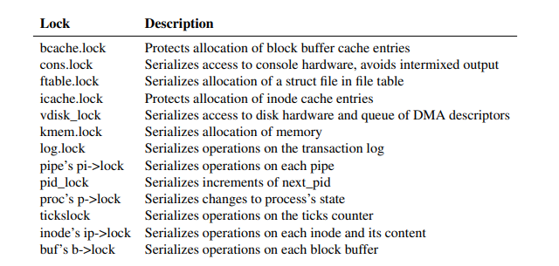
Locks in xv6

Slide 52
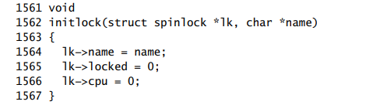
initlock

Slide 53
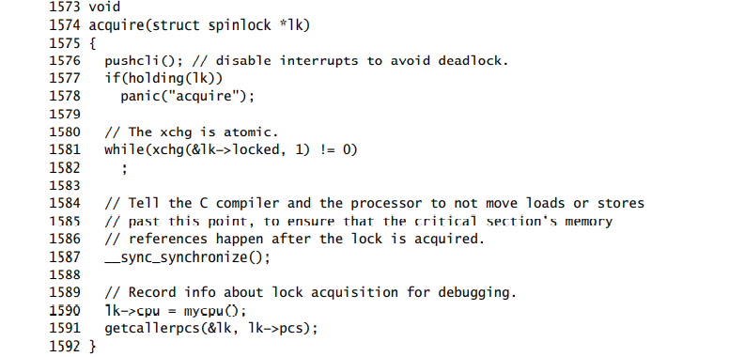
acquire

Slide 54
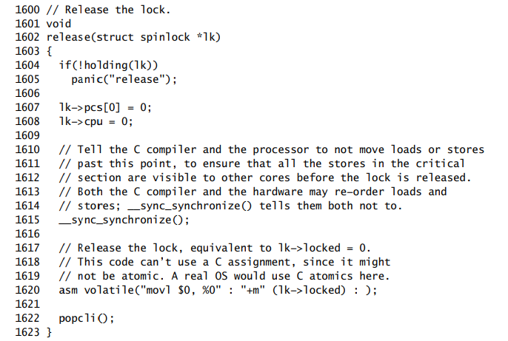
release

Slide 55
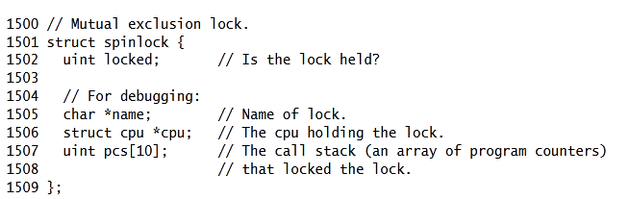

Slide 56
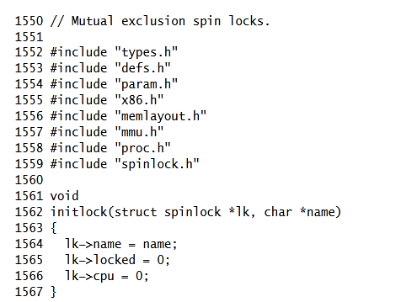
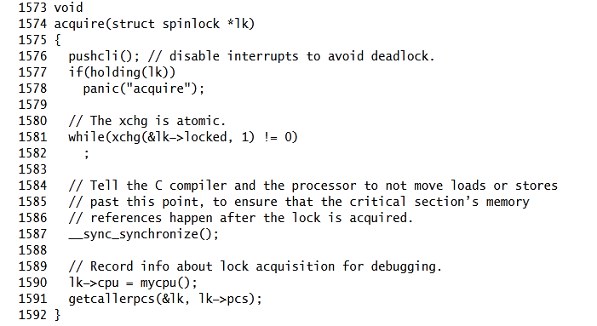
Spin Lock

Slide 57
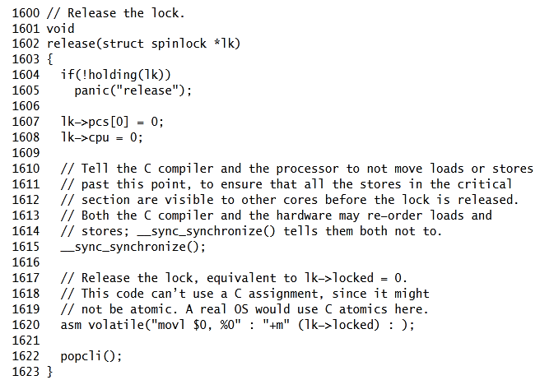

Slide 58
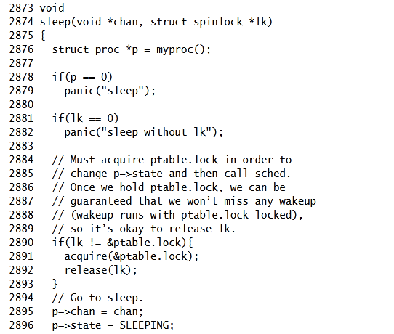

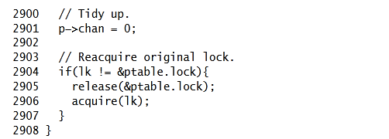

Slide 59
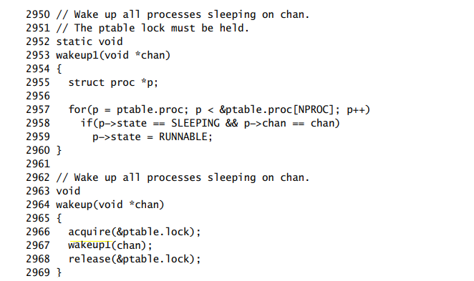
wakeup

Slide 60
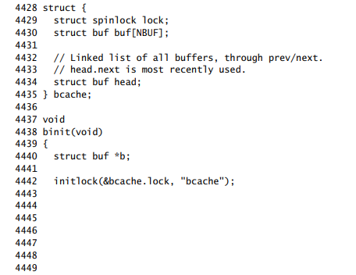
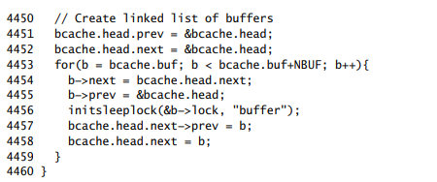
bcache.lock

Slide 61
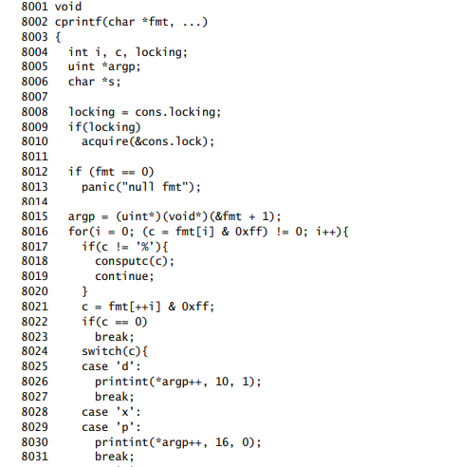
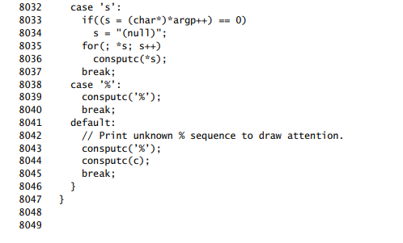

cons.lock

Slide 62
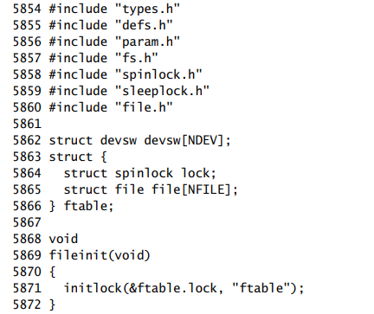
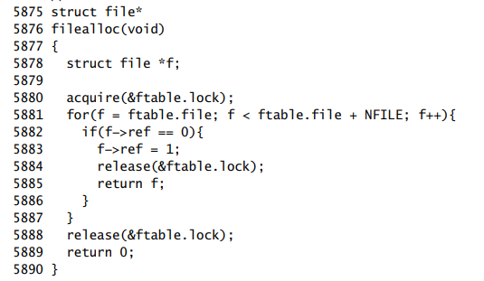
ftable.lock

Slide 63
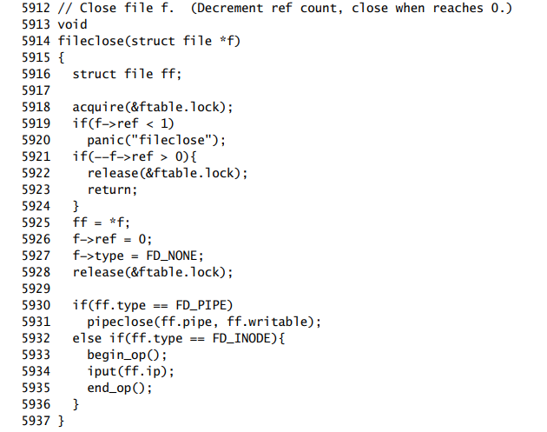
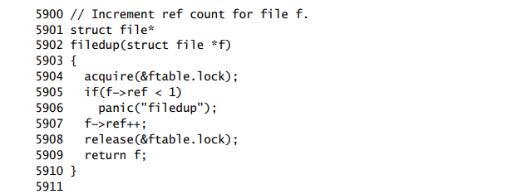

Slide 64
Thank you

